Slide 1
CS 0447 Recitation 10

Slide 2
Last Week’s Quiz
Q1
A: 3
The lengths sides of a rectangle in a K-map must be powers of 2
Q2
A: ~Y + ~X~Z
For each rectangle, remove the variable(s) that do not change. Then, OR the terms together
Notes:
Q1 Which of the following is NOT an acceptable length for the size of a rectangle in a K-Map?
Q2 What is the final expression produced from the K-map below?

Slide 3
Last Week’s Quiz
Q3:
A: d4
d4 corresponds to the decimal place, so we don’t need it for single digit numbers
Q4:
A: 125 MHz
To figure out clock speed, we divide 1 by the speed of the critical path
Notes:
Q3 In a 7 segment LED display, which of the outputs (d0 - d7) always holds the value of 0 when representing single decimal digits (0 - 9)?
Q4 It takes 8 ns for a signal to propagate through the circuit. What is the fastest that we can clock it?

Slide 4
This Week’s Quiz
You have 5 minutes to work on the quiz

Slide 5
Parts of a CPU
A CPU has three main parts
Registers
Hold the values being computed
Control
Tells everything what to do and when
Datapath
Computes new values
Let’s focus on the registers

Slide 6
The Registers
Registers are grouped together into the register file
The register file is connected to the control and ALU
The ALU is the main part of the datapath; more on it later
Two registers can be read at once
This is why we can do things like add the contents of two registers together

Slide 7
Register File Design Consideration
All designs are trade-offs
If we have lots of registers function calls are faster! But context switching is slower
Compilers like there to be lots of identical registers! But more registers cost more money
32 registers is a solid middle ground between several design considerations

Slide 8
Building a Register File
We discussed flip-flops last week
Remember that we can create a 1-bit register using D flip-flops
We can combine 32 of these to create 32 bit register!
Then we combine a bunch of registers together to create the register file

Slide 9
MIPS Register File
The MIPS register file has one input (write port) and two outputs (read ports)
It also takes a clock signal, a write-enable, and inputs to select the registers to use
Read ports
We need to choose which register to read from – so use a MUX
A read port is made up of a select signal, a MUX, and an output

Slide 10
MIPS Register File
Write ports
We only want to write to one register, so we have a select signal again
But not all instructions write, so we have a write-enable signal
We can use a DEMUX to send the input to the proper register
Remember that a DEMUX takes an input, and sends it to one of many outputs
A write port consists of:
A select signal
A data input
A write enable
Logic to send the write enable signal to one register

Slide 11
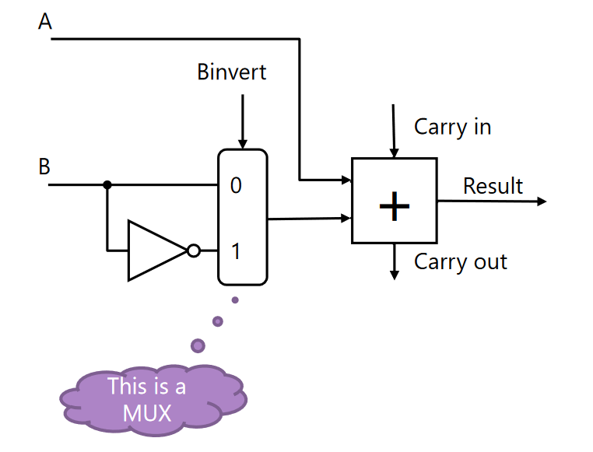
Building a Basic ALU
ALU – Arithmetic and Logic Unit
Let’s start simple and create an ALU that can add or subtract
Using a MUX, we can choose whether to add or to subtract
Notes:
If the mux select is 1, B is inverted and subtraction occurs

Slide 12
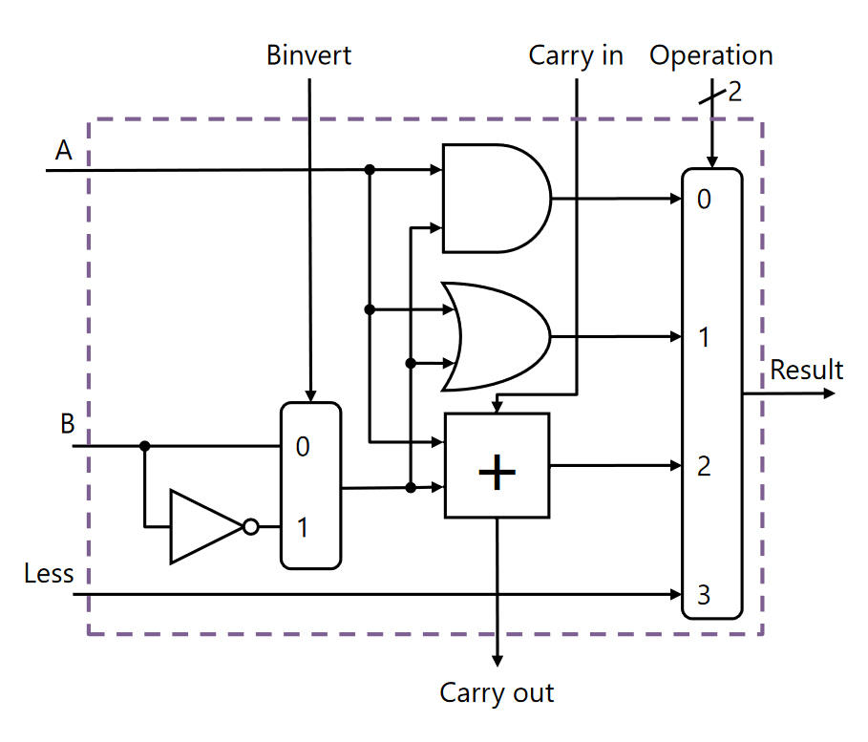
Expanding our ALU
This ALU can add, subtract, and perform bitwise ANDs, ORs, and NOTs
The operation is chosen by the Operation MUX
The ALU has other inputs/outputs as needed
This is basically how building an ALU goes – we add more components and use a MUX to choose what happens

Slide 13
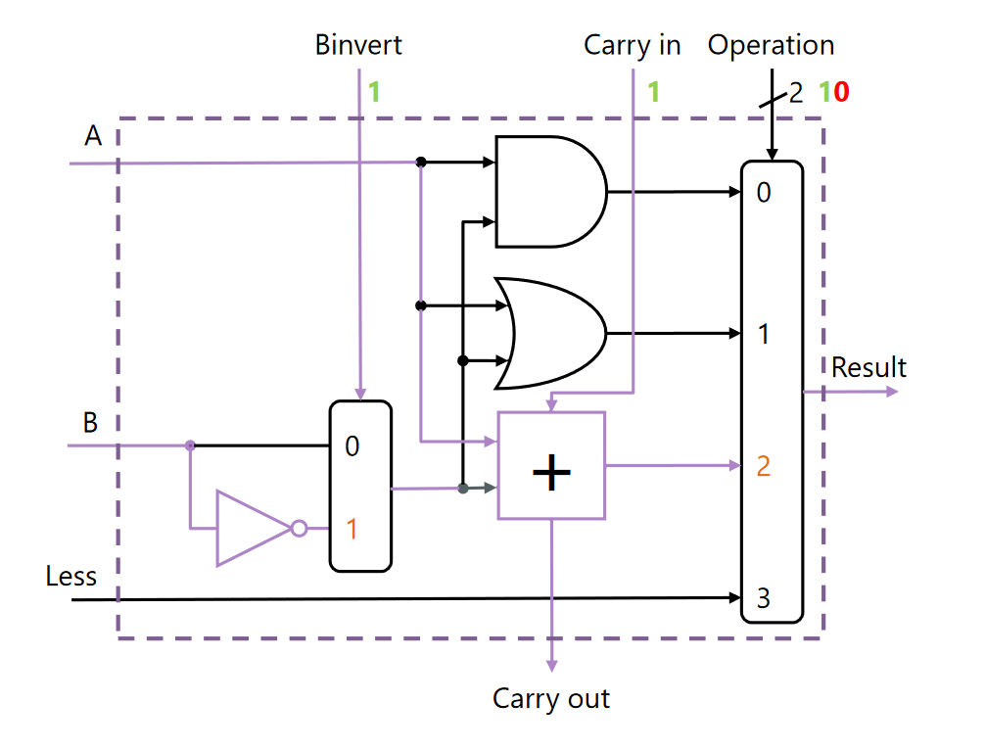
Example
We want to subtract
Binvert and Carry in are set to 1 – remember how subtracting using an adder works
We set the operation select to give us the output of the adder
Note that all possible operations are done, but only one is sent out of the ALU

Slide 14
ALU Wrapup
We can combine 32 of these 1-bit ALUs into a 32 bit ALU
Connect the carry-in and carry-out inputs of each small ALU
Make sure signals like operation are the same for each small ALU
In Logisim we can just make one ALU and tell Logisim make the components’ data size 32 bits

Slide 15
Lab 10 Part A
Follow along with the directions and build the CookieWatcher subcircuit
Switch to the main circuit and follow along with the directions to add several CookieWatchers
Your submission is the two circuits described above
You should also think about how the circuits work – why are the lights turning on, and what happens when a button is pressed?

Slide 16
Lab 10 Part B
You will be building a register file
The lab description specifies the inputs/outputs of the register file
Remember what some circuits do:
MUX – takes many inputs and chooses 1
DEMUX – takes one input and sends it to one of many outputs
There are very detailed hints/instructions in the lab description that you should follow along with

